Slide 1
UNIT III Network Layer
Network Layer Design Issues
• Store-and-forward packet switching
• Services provided to transport layer
• Implementation of connectionless service
• Implementation of connection-oriented service
• Comparison of virtual-circuit and datagram networks

Slide 2
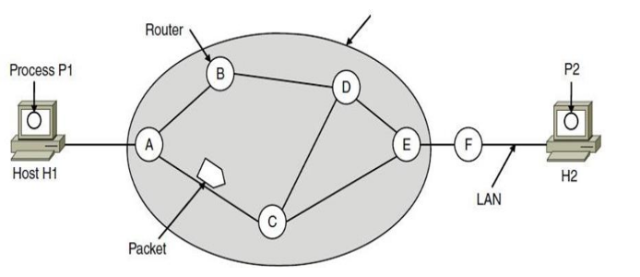
1.Store-and-forward packet switching
1.Store-and-forward packet switching A host with a packet to send transmits it to the nearest router, either on its own LAN or over a point-to-point link to the ISP.

Slide 3
The packet is stored there until it has fully arrived and the link has finished its processing by verifying the checksum.
Then it is forwarded to the next router along the path until it reaches the destination host, where it is delivered. This mechanism is store-and-forward packet switching.
2.Services provided to transport layer
The network layer provides services to the transport layer at the network layer/transport layer interface. The services Need to be carefully designed with the following goals in mind:
Services independent of router technology.
Transport layer shielded from number, type, topology of routers.
Network addresses available to transport layer use uniform numbering plan even across LANs and WANs

Slide 4
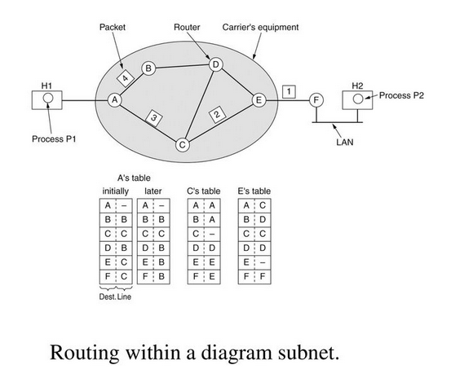
3.Implementation of connectionless service
If connectionless service is offered, packets are injected into the network individually and routed independently of each other.
• No advance setup is needed. In this context, the packets are frequently called datagrams (in analogy with telegrams) and the network is called a datagram network

Slide 5
Implementation of connectionless service
Let us assume for this example that the message is four times longer than the maximum packet size, so the network layer has to break it into four packets, 1, 2, 3, and 4, and send each of them in turn to router A.
Every router has an internal table telling it where to send packets for each of the possible destinations.
Each table entry is a pair(destination and the outgoing line). Only directly connected lines can be used.

Slide 6
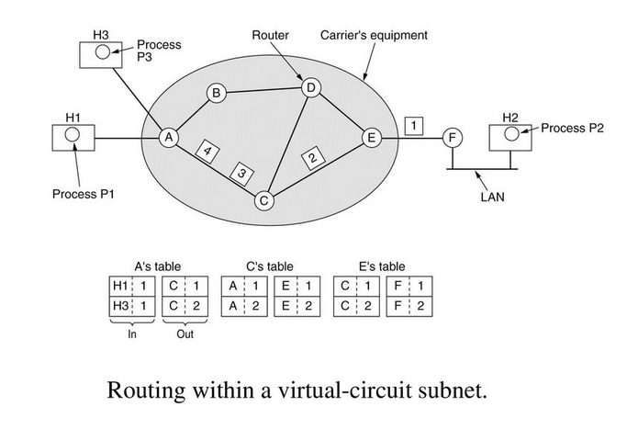
4.Implementation of connection-oriented service

Slide 7
Implementation of connection-oriented service
If connection-oriented service is used, a path from the source router all the way to the destination router must be established before any data packets can be sent. This connection is called a VC (virtual circuit), and the network is called a virtual-circuit network
• When a connection is established, a route from the source machine to the destination machine is chosen as part of the connection setup and stored in tables inside the routers.

Slide 8
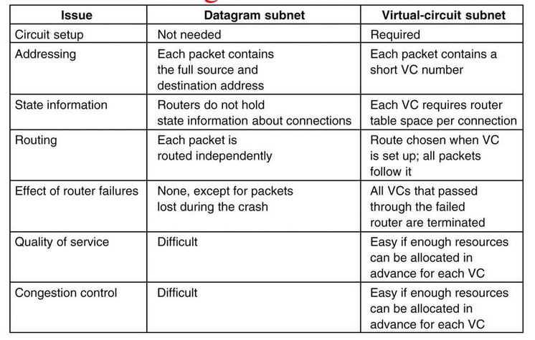
5.Comparison of virtual-circuit and datagram networks

Slide 9
Routing Algorithms
The main function of NL (Network Layer) is routing packets from the source machine to the destination machine.
There are two processes inside router:
a)One of them handles each packet as it arrives, looking up the outgoing line to use for it in the routing table. This process is forwarding.
b)The other process is responsible for filling in and updating the routing tables. That is where the routing algorithm comes into play. This process is routing.

Slide 10
Routing algorithms can be grouped into two major classes: –
Nonadaptive (Static Routing) – Adaptive(Dynamic Routing)
Nonadaptive algorithm do not base their routing decisions on measurements or estimates of the current traffic and topology. Instead, the choice of the route to use to get from I to J is computed in advance, off line, and downloaded to the routers when the network is booted. This procedure is sometimes called static routing.
Adaptive algorithm, in contrast, change their routing decisions to reflect changes in the topology, and usually the traffic as well.

Slide 11
Different Routing Algorithms
• Optimality principle
• Shortest path algorithm
• Flooding
• Distance vector routing
• Link state routing
• Hierarchical Routing

Slide 12
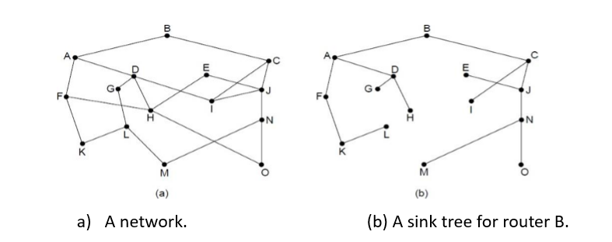
Optimality principle One can make a general statement about optimal routes without regard to network topology or traffic. This statement is known as the optimality principle.

Slide 13
The Optimality Principle
It states that if router J is on the optimal path from router I to router K, then the optimal path from J to K also falls along the same
As a direct consequence of the optimality principle, we can see that the set of optimal routes from all sources to a given destination form a tree rooted at the destination. Such a tree is called a sink tree.

Slide 14
Shortest Path Routing (Dijkstra’s)
The idea is to build a graph of the subnet, with each node of the graph representing a router and each arc of the graph representing a communication line or link.
To choose a route between a given pair of routers, the algorithm just finds the shortest path between them on the graph
Start with the local node (router) as the root of the tree. Assign a cost of 0 to this node and make it the first permanent node.
Examine each neighbor of the node that was the last permanent node.
Assign a cumulative cost to each node and make it tentative
Among the list of tentative nodes
Find the node with the smallest cost and make it Permanent
If a node can be reached from more than one route then select the route with the shortest cumulative cost.

Slide 15
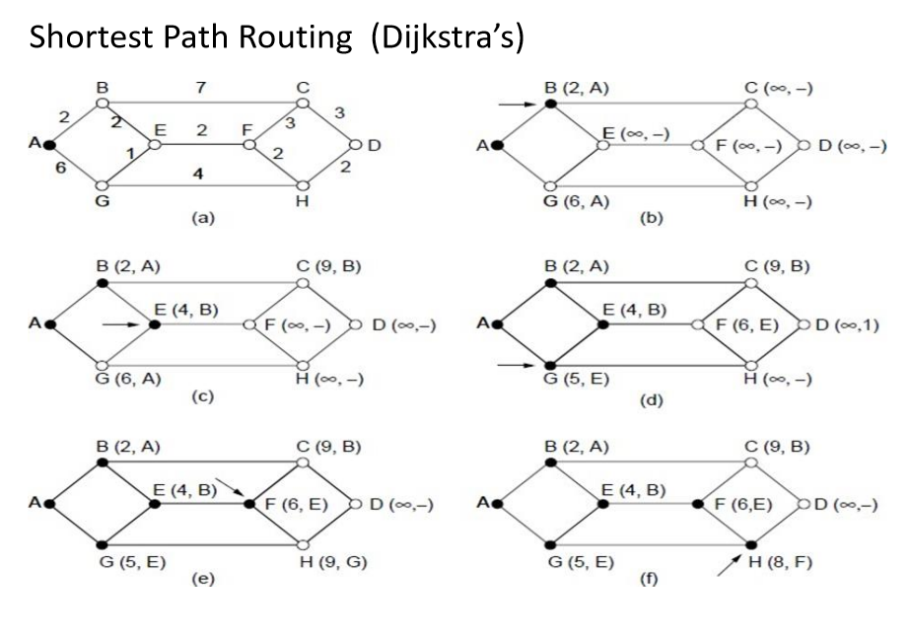

Slide 16
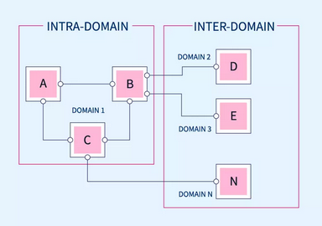
Interdomain Routing is the protocol in which the routing algorithm works both within and between domains. Domains must be connected in some way, for hosts inside one domain to exchange data with hosts in other domains.
Intradomain Routing is the routing protocol that operates only within a domain. In other words, intradomain routing protocols are used to route packets within a specific domain, such as within an institutional network for e-mail or web browsing

Slide 17
Flooding
Flooding is a Non-adaptive routing technique following this simple method: when a data packet arrives at a router, it is sent to all the outgoing links except the one it has arrived on.
For example, let us consider the Network in the figure, having six routers that are connected through transmission lines.

Slide 18
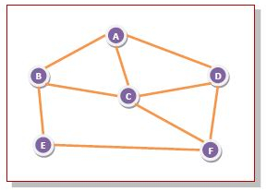
Using flooding technique −
An incoming packet to A, will be sent to B, C and D.
B will send the packet to C and E.
C will send the packet to B, D and F.
D will send the packet to C and F.
E will send the packet to F.
F will send the packet to C and E.

Slide 19
Types of Flooding
Flooding may be of three types −
Uncontrolled flooding − Here, each router unconditionally transmits the incoming data packets to all its neighbours.
Controlled flooding − They use some methods to control the transmission of packets to the neighbouring nodes. The two popular algorithms for controlled flooding are Sequence Number Controlled Flooding (SNCF) and Reverse Path Forwarding (RPF).
Selective flooding − Here, the routers don't transmit the incoming packets only along those paths which are heading towards approximately in the right direction, instead of every available paths.

Slide 20
Advantages of Flooding
It is very simple to setup and implement, since a router may know only its neighbours.
It is extremely robust. Even in case of malfunctioning of a large number routers, the packets find a way to reach the destination.
Limitations of Flooding
Flooding tends to create an infinite number of duplicate data packets, unless some measures are adopted to damp packet generation.

Slide 21
Hierarchical Routing
As networks grow in size, the router routing tables grow proportionally. Not only is router memory consumed by ever-increasing tables, but more CPU time is needed to scan them and more bandwidth is needed to send status reports about them.
At a certain point, the network may grow to the point where it is no longer feasible for every router to have an entry for every other router, so the routing will have to be done hierarchically, as it is in the telephone network.

Slide 22
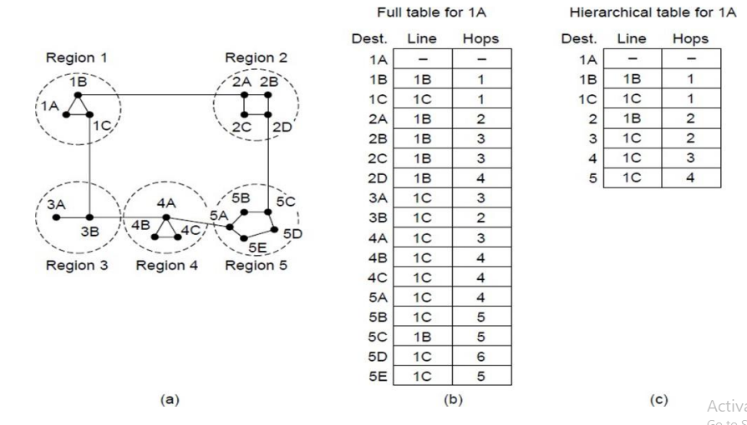
Hierarchical Routing

Slide 23
Distance Vector Routing (Bellman ford Algorithm)
In distance vector routing, the least-cost route between any two nodes is the route with minimum distance. In this protocol, as the name implies, each node maintains a vector (table) of minimum distances to every node.
Mainly
Initialization of tables in distance vector routing
Sharing,
Updating
Each node can know only the distance between itself and its immediate neighbors, those directly connected to it. So for the moment, we assume that each node can send a message to the immediate neighbors and find the distance between itself and these neighbors.

Slide 24
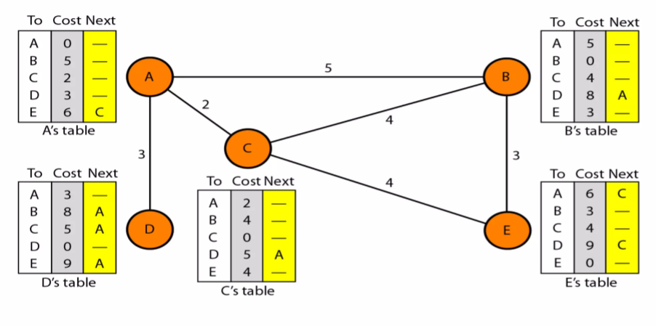
Initialization of tables in distance vector routing

Slide 25
These tables are updated by exchanging information with the neighbors.
In distance vector routing, each router maintains a routing table indexed by, and containing one entry for, each router in the subnet.
This entry contains two parts: the preferred outgoing line to use for that destination and an estimate of the time or distance to that destination.
The metric used might be number of hops, time delay in milliseconds, total number of packets queued along the path, or something similar.

Slide 26
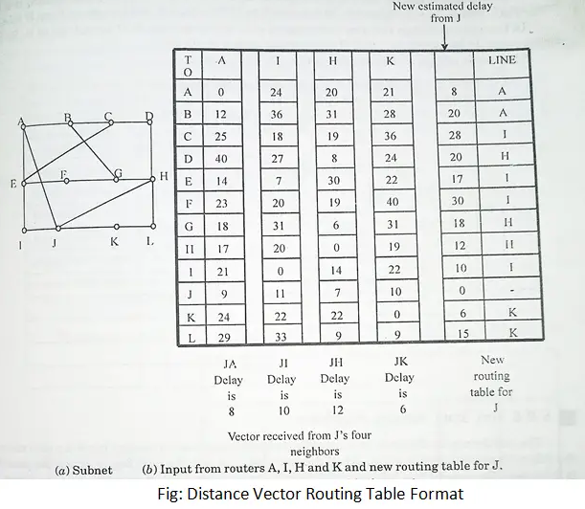
Distance Vector Routing

Slide 27
Count to infinity problem:
One of the important issue in Distance Vector Routing is County of Infinity Problem.
Counting to infinity is just another name for a routing loop.
In distance vector routing, routing loops usually occur when an interface goes down.
It can also occur when two routers send updates to each other at the same time.

Slide 28
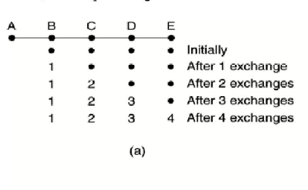
Since the Bellman-Ford algorithm is unable to prevent loops, the fundamental problem with Distance Vector Routing (DVR) protocols is Routing Loops. The Count to Infinity Problem is brought on by this routing loop in the DVR network. When two routers deliver updates simultaneously or when an interface goes down, routing loops frequently happen.

Slide 29
